Slide 1

The Larpers: Adi Tauqir, Wilder Edwards
Budget Bites: Track campus meals, plans
Mobile Application Development
Notes:
Slide 1 — Introduction
[On screen: Start on Home in the emulator.]
“Hi, I’m Adi, and I worked on the front end of Budget Bites. This app helps students keep track of meals, plans, and what they actually paid, so they can see how much food budget is left.
I’ll show the main screens, how a purchase gets recorded, how History can be filtered and edited, and how Lunch Lens suggests a price. I entered the demo records on this emulator before recording. The menu items and listed prices come from the app’s menu snapshots. The receipt prices are made up for this demo.”
[go to lines 273, file is /Users/aditauqir/Code/MadProjects/MAD-FAFO/projectOne/budgetbites/lib/main.dart]

Slide 2
Problem
Approach
What will you get
Small food purchases make it hard to know how much budget is left.
What you do is enter meal, place, price, date, servings, plan/receipt status, and budgets.
Daily and weekly balance, filtered history, and a local price guide.

Slide 3
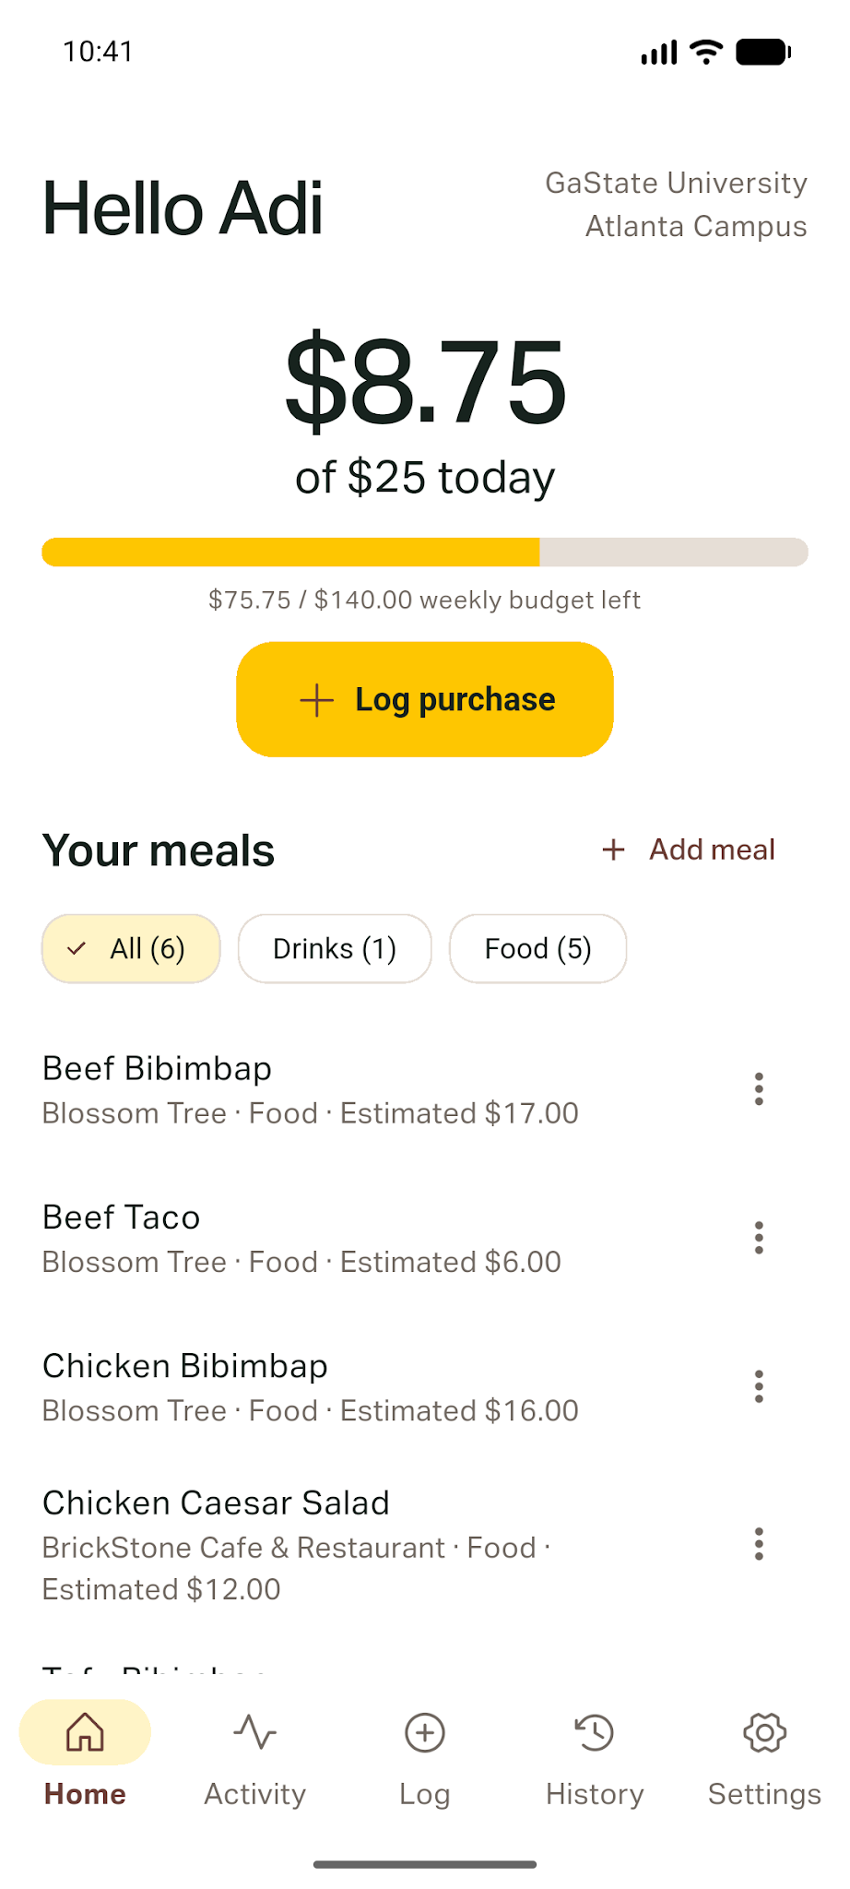
Home screen
daily + weekly budget
Remaining budget
$16.25
$140.00 (this is the weekly) − $64.25 = $75.75 (for the week)
Notes:
Slide 3 — Home · daily and weekly budget
[On screen: Point to today’s remaining amount and the weekly amount. Tap Log.]
“For this demo, the daily budget is $25. Home shows the budget left for the current day and week.
The three Chicken Bibimbap receipts are $15.50, $16, and $16.50. The amounts on screen depend on the current date and saved receipts.”
[go to lines 136, file is /Users/aditauqir/Code/MadProjects/MAD-FAFO/projectOne/budgetbites/lib/screens/home_screen.dart]
[go to lines 160, file is /Users/aditauqir/Code/MadProjects/MAD-FAFO/projectOne/budgetbites/lib/screens/home_screen.dart]

Slide 4
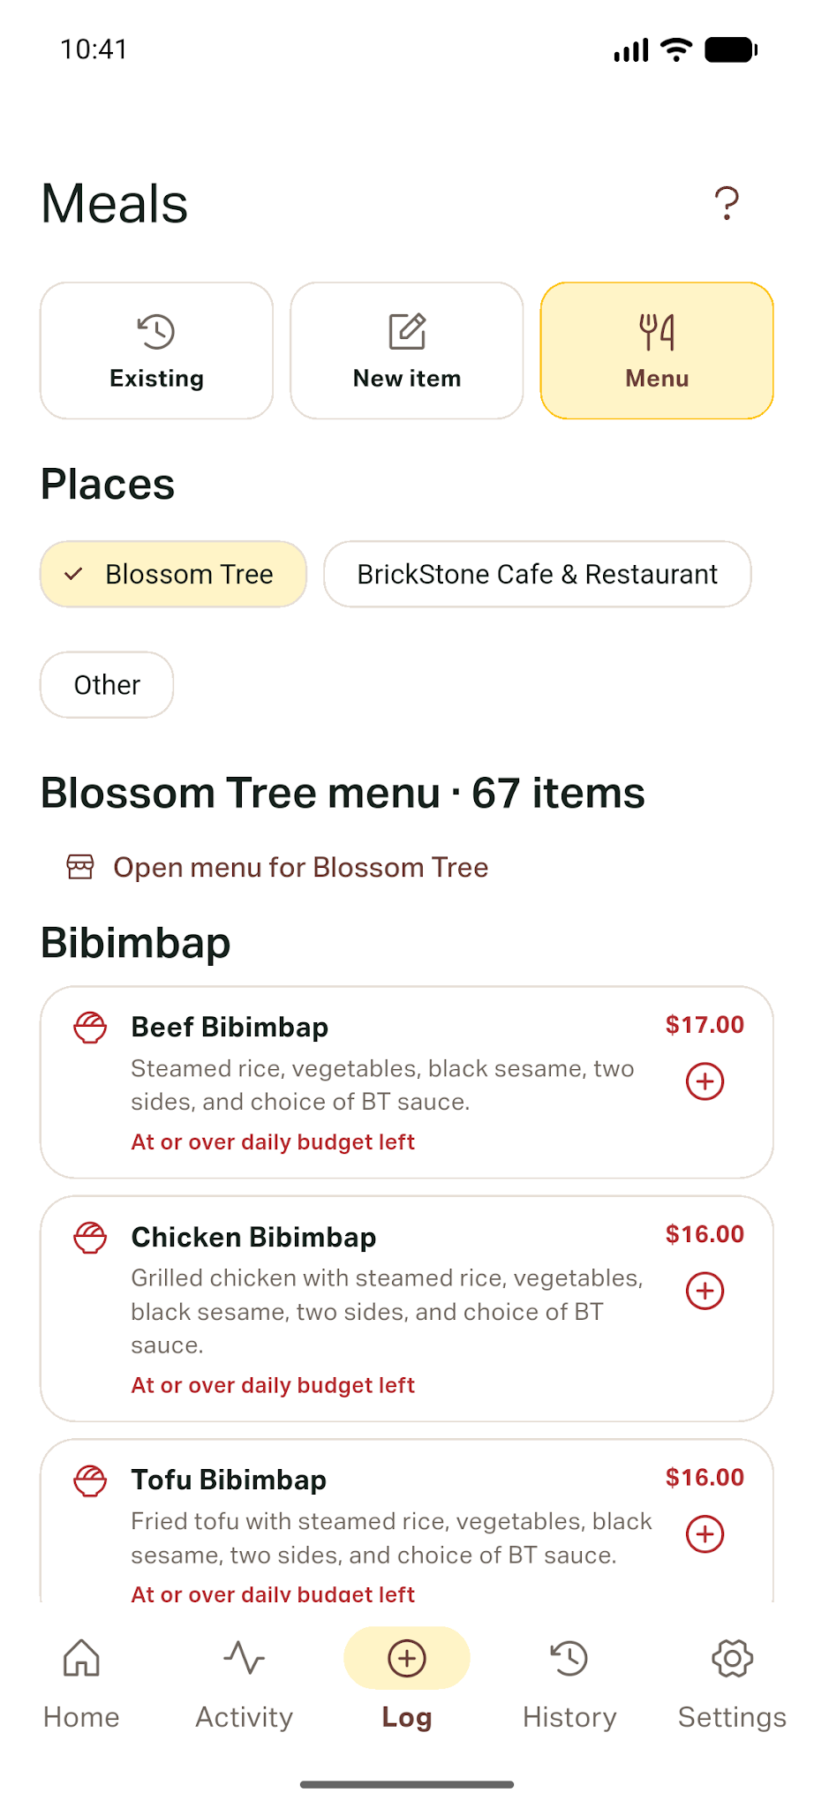
Log screen menu + receipt
You can pick a meal from the menu or add your own.
Opening a meal won’t save a purchase, its just for showing
Put in what you actually paid for it.
If the price is wrong, the app asks you to fix it.
Tap to finish for saving
purchase_editor.dart · lines 149–152, 165–168 (shortened)
if (_saving) return;
final price = parseMoneyToCents(_priceController.text);
if (price == null) { setState(() => _error = 'Enter a price like 5.50.'); return; }
Notes:
Slide 4 — Log · browse a menu and validate a receipt
[On screen: In Log, select Menu, choose Blossom Tree, show Chicken Bibimbap, and open its details. Go back without saving. Then select New item, enter an invalid price, show the error, and cancel.]
“On Log, I can choose an existing meal, enter a new item, or browse a restaurant menu. Chicken Bibimbap is listed at $16 in the Blossom Tree menu snapshot. I can open its details before logging anything, so just looking through the menu won’t accidentally add spending.
The menu price is a reference. The receipt is where I enter what I paid. For this demo, those receipt amounts are fictional.
The purchase form checks the item, store, price, servings, and date before saving. If I enter an invalid price, it tells me what to fix and doesn’t save the entry. Save also locks while a write is in progress, so tapping twice doesn’t make two receipts.”
[go to lines 105, file is /Users/aditauqir/Code/MadProjects/MAD-FAFO/projectOne/budgetbites/lib/screens/log_screen.dart]
[go to lines 34, file is /Users/aditauqir/Code/MadProjects/MAD-FAFO/projectOne/budgetbites/lib/data/blossom_tree.dart]
[go to lines 303, file is /Users/aditauqir/Code/MadProjects/MAD-FAFO/projectOne/budgetbites/lib/screens/log_screen.dart]
[go to lines 149, file is /Users/aditauqir/Code/MadProjects/MAD-FAFO/projectOne/budgetbites/lib/widgets/purchase_editor.dart]
[go to lines 165, file is /Users/aditauqir/Code/MadProjects/MAD-FAFO/projectOne/budgetbites/lib/widgets/purchase_editor.dart]

Slide 5
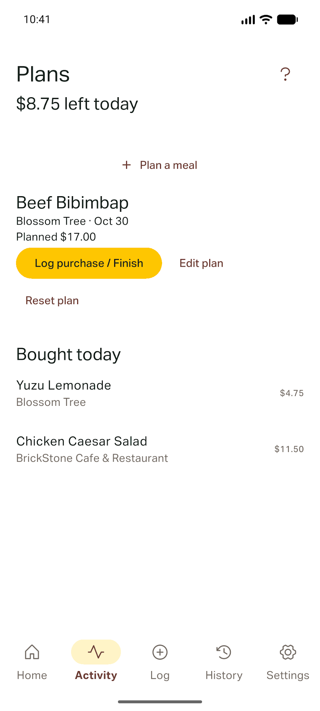
Activity screen · meal plans
A meal plan shows up on Activity.
It won’t count as spending until you log it.
You can reset the plan and keep the old receipts.
Notes:
Slide 5 — Activity · a plan is not spending
[On screen: Tap Activity. Show the unconfirmed Beef Bibimbap plan and its actions. Reset the plan.]
“This Beef Bibimbap is still a plan. It doesn’t count as money spent until I log it as a purchase. If I buy it, I can finish the plan by entering what I paid. Reset removes the plan; older receipts stay in History.”
[go to lines 20, file is /Users/aditauqir/Code/MadProjects/MAD-FAFO/projectOne/budgetbites/lib/screens/activity_screen.dart]
[go to lines 70, file is /Users/aditauqir/Code/MadProjects/MAD-FAFO/projectOne/budgetbites/lib/screens/activity_screen.dart]
[go to lines 83, file is /Users/aditauqir/Code/MadProjects/MAD-FAFO/projectOne/budgetbites/lib/screens/activity_screen.dart]

Slide 6
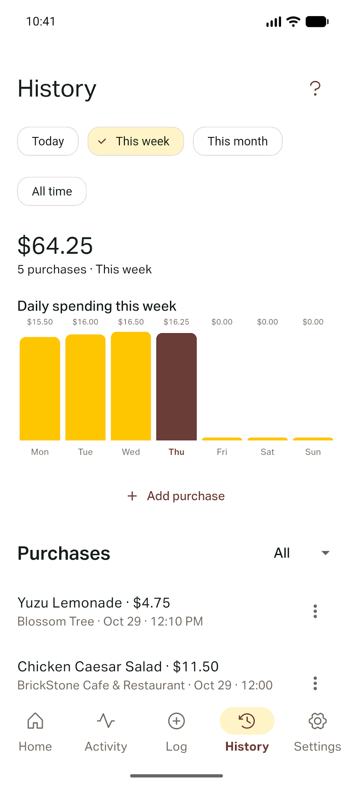
History screen · find and change purchases
Pick a time and category to find purchases.
No matches? The app tells you there’s nothing there.
Change $6 to $5.50, and $10.50 becomes $10.
Delete the $4.50 receipt and $5.50 is left.
history_screen.dart · lines 119–124
if (history.isEmpty)
const EmptyMessage(
title: 'No purchases here yet',
detail: 'Try another period or add a purchase.',
)
Notes:
Slide 6 — History · filter, edit, and delete
[On screen: Tap History. Show This week, choose Misc to show no results, and switch back to Food. Choose This month. Edit the $6 Beef Taco receipt to $5.50, then delete the $4.50 receipt.]
“History shows confirmed purchases. I can filter by time period or category, and the total follows the rows shown. I’ll choose Misc to show the empty state, then switch back to Food.
These two Beef Taco receipts are the separate edit and delete example. They start at $4.50 and $6, which adds up to $10.50. I change the $6 receipt to $5.50, so the two rows now total $10. Then I delete the $4.50 one, leaving $5.50.
Those test receipts are dated October 25, before this week. With the dates in the ZIP, the month total starts at $74.75, becomes $74.25 after the edit, and $69.75 after the delete. This week’s $64.25 and today’s $16.25 stay the same.”
[go to lines 75, file is /Users/aditauqir/Code/MadProjects/MAD-FAFO/projectOne/budgetbites/lib/screens/history_screen.dart]
[go to lines 119, file is /Users/aditauqir/Code/MadProjects/MAD-FAFO/projectOne/budgetbites/lib/screens/history_screen.dart]
[go to lines 190, file is /Users/aditauqir/Code/MadProjects/MAD-FAFO/projectOne/budgetbites/lib/screens/history_screen.dart]
[go to lines 198, file is /Users/aditauqir/Code/MadProjects/MAD-FAFO/projectOne/budgetbites/lib/screens/history_screen.dart]

Slide 7
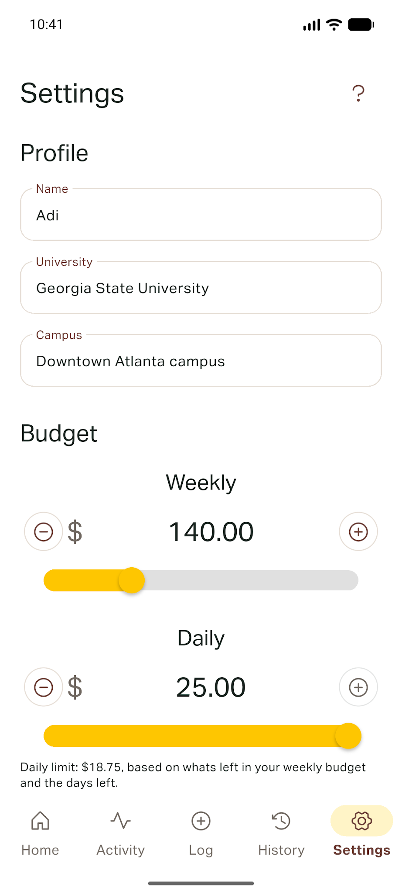
Settings screen · budgets
Set how much you want to spend each day and week.
For the demo, we used $25 a day and $140 a week.
The fields and buttons have labels so you know what they do.
Notes:
Slide 7 — Settings · budgets and clear controls
[On screen: Tap Settings and show the daily and weekly amounts. Don’t change them.]
“I set the daily budget to $25 and the weekly budget to $140. The screen has labeled controls, and the spacing adjusts with screen width. The navigation tabs and buttons have text labels, so they aren’t icons with no description.”
[go to lines 378, file is /Users/aditauqir/Code/MadProjects/MAD-FAFO/projectOne/budgetbites/lib/screens/settings_screen.dart]
[go to lines 286, file is /Users/aditauqir/Code/MadProjects/MAD-FAFO/projectOne/budgetbites/lib/main.dart]
[go to lines 188, file is /Users/aditauqir/Code/MadProjects/MAD-FAFO/projectOne/budgetbites/lib/screens/home_screen.dart]

Slide 8
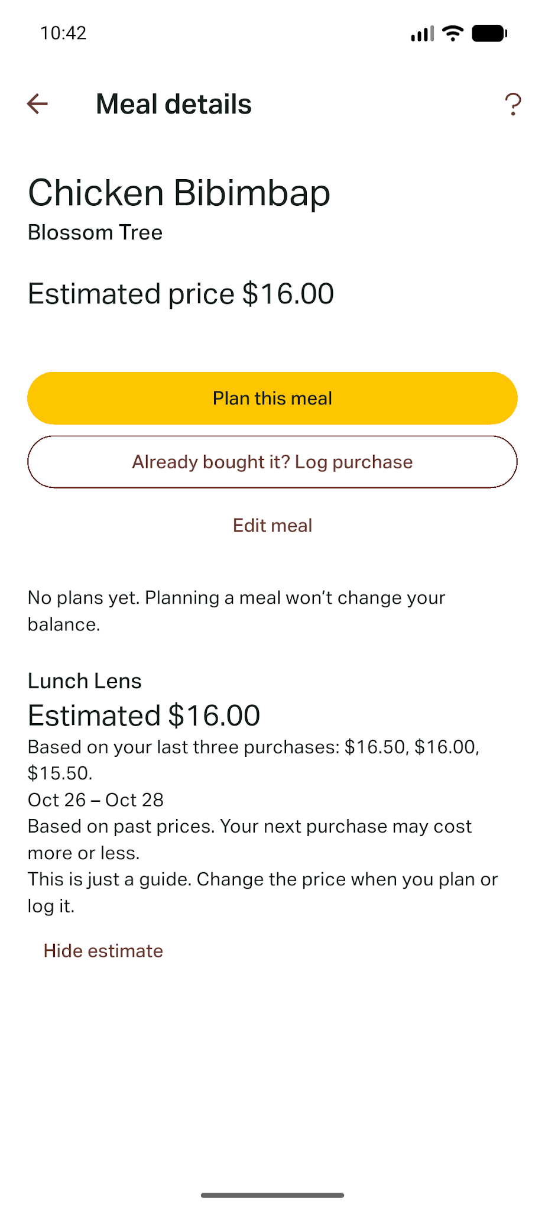
Lunch Lens · price suggestions
Lunch Lens looks at three confirmed purchases.
$15.50, $16 and $16.50 give an average of $16.
With no receipts, it asks you to log the meal first.
One really high or low price can change the average.
widgets/lunch_lens.dart · lines 51–55
if (estimate == null)
const Text('Log this meal three times to get a price suggestion.')
Notes:
Slide 8 — Lunch Lens · estimate, baseline, and no-data case
[On screen: Go Home, open saved Chicken Bibimbap, and show Lunch Lens. Go back and open Tofu Bibimbap.]
“Here’s Lunch Lens for Chicken Bibimbap. It uses the three confirmed receipts: $15.50, $16, and $16.50. Their average is $16. The last-price baseline is $16.50.
If the next receipt were $15.50, the estimate would be 50 cents away, while the last-price baseline would be a dollar away. That’s one example where the average helps. It’s still only a guide, and I can change the amount when I log a purchase.
To show the no-data case, I’ll open Tofu Bibimbap. It has no confirmed receipts, so Lunch Lens doesn’t guess a price. It tells me to log the meal three times first.
The test cases also cover fewer than three receipts, ignoring plans, other meals and future receipts, using only the most recent three, and an outlier. In the outlier example, $5, $20, and $5 average to $10. One unusual price can pull the mean away from what someone usually pays.”
[go to lines 261, file is /Users/aditauqir/Code/MadProjects/MAD-FAFO/projectOne/budgetbites/lib/screens/home_screen.dart]
[go to lines 148, file is /Users/aditauqir/Code/MadProjects/MAD-FAFO/projectOne/budgetbites/lib/screens/meal_detail_screen.dart]
[go to lines 40, file is /Users/aditauqir/Code/MadProjects/MAD-FAFO/projectOne/budgetbites/lib/widgets/lunch_lens.dart]
[go to lines 52, file is /Users/aditauqir/Code/MadProjects/MAD-FAFO/projectOne/budgetbites/lib/widgets/lunch_lens.dart]
Testing portion (~45 seconds):
“Testing is grouped into helper edge cases, data edits, and screen behavior. The edit/delete check starts at $4.50 plus $6.00, or $10.50. Editing the $6 receipt to $5.50 gives $10.00, and deleting the $4.50 receipt leaves $5.50.
Lunch Lens test cases cover a normal three-price example, fewer than three receipts, excluded plans, other meals and future receipts, newest-three selection, and an outlier. The manual checklist covers invalid input, filters, delete and reset, accessibility, responsive layout, and closing and reopening offline. I’ll use the run log for actual pass/fail results.”
[go to lines 45, file is /Users/aditauqir/Code/MadProjects/MAD-FAFO/projectOne/budgetbites/lib/logic/lunch_lens.dart]
[go to lines 54, file is /Users/aditauqir/Code/MadProjects/MAD-FAFO/projectOne/budgetbites/test/lunch_lens_test.dart]
[go to lines 99, file is /Users/aditauqir/Code/MadProjects/MAD-FAFO/projectOne/budgetbites/test/lunch_lens_test.dart]
[go to lines 116, file is /Users/aditauqir/Code/MadProjects/MAD-FAFO/projectOne/budgetbites/test/lunch_lens_test.dart]
[go to lines 169, file is /Users/aditauqir/Code/MadProjects/MAD-FAFO/projectOne/budgetbites/test/lunch_lens_test.dart]

Slide 9
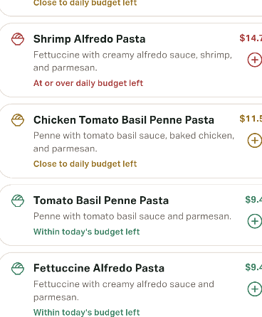
What our peer told us
We discussed how some pages and budget status were hard to understand.
We added page help and colored price labels; the peer said they were clearer.
Wilder found the purchase flow and save confirmation confusing.
We updated the save message to include the daily budget left.
On recheck, it was easier; History totals and tab names still need work.
Notes:
Slide 9 — Peer feedback · what we changed
[On screen: Show the feedback slide and the colored menu labels. Explain the before and after save message and Wilder’s retest.]
“We discussed the feedback together after a peer went through the usual app flow. Some pages were hard to understand, and the peer wanted to see the budget status faster. We added the question-mark help and colored price labels. When they tried the flow again, they said the colors made it clearer.
Wilder also tried the task of planning or logging lunch and finding his spending. He reached an empty Existing tab, had to find New item, and the keyboard covered some controls. The small ‘Purchase saved’ message didn’t tell him the budget result, so we discussed showing the daily amount left in the confirmation.
The before message was ‘Purchase saved.’ The updated message includes the amount left, such as ‘Purchase saved · $11.50 left today.’ Wilder’s reported retest was a $3.25 coffee with $8.25 left, and History showed $11.75 across two purchases. He said that was easier, but the big History total and the Existing, New item, and Menu labels still felt unclear. Those are things we’d look at next.”

Slide 10

Offline data + what we would change
Meals, receipts and budgets are saved on the device.
Close and reopen the app offline to check they’re still there.
Next, I’d compare the middle price with the average.
The app would still keep everything local.
app_database.dart · line 30 / preferences_store.dart · line 72
final databasePath = p.join(await getDatabasesPath(), 'budget_bites.db');
await _preferences.setInt('budget.dailyCents', settings.dailyBudgetCents);
Notes:
Slide 10 — Offline restart · next iteration
[On screen: Return Home, turn on airplane mode, close and reopen the same app install, and show the saved budget and meals.]
“The records are stored on this device. Meals and purchases use the local SQLite database, and the budget settings are saved on the device too. I’m reopening the same emulator app while offline, and the saved entries are still here. I’ll keep using this emulator install for the demo, since clearing the app’s storage or uninstalling it would remove the local data.
For the next iteration, the choice I’d revisit is using the mean of the last three prices. It’s simple to explain, but the outlier example shows its limit. My first task would be to compare the median with the mean for the same three confirmed prices. I’d own that task. I’d verify the normal, no-data, fewer-than-three, and outlier cases, then check that the saved results still work offline after a restart. That keeps the same menu topics and local-only storage. This is a proposed next step, not a change in this build.
That’s my front-end walkthrough. I’ll hand it over to Wilder to explain the app structure and the data side.”
[go to lines 37, file is /Users/aditauqir/Code/MadProjects/MAD-FAFO/projectOne/budgetbites/lib/data/app_database.dart]
[go to lines 145, file is /Users/aditauqir/Code/MadProjects/MAD-FAFO/projectOne/budgetbites/lib/data/app_database.dart]
[go to lines 71, file is /Users/aditauqir/Code/MadProjects/MAD-FAFO/projectOne/budgetbites/lib/data/preferences_store.dart]
[go to lines 169, file is /Users/aditauqir/Code/MadProjects/MAD-FAFO/projectOne/budgetbites/test/lunch_lens_test.dart]

Slide 11
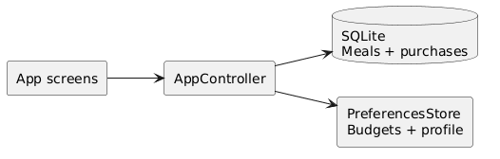
How the app is put together
As the UML diagram shows, screens talk to AppController.
The controller loads and updates the data.
SQLite saves meals and purchases.
PreferencesStore saves the budget and profile.
Notes:
SLIDE 11 — ARCHITECTURE · UI, STATE, AND LOCAL DATA
[Partner: Show the class/data relationships and explain the UI-to-storage path.]
“Flutter screens call the shared AppController. It loads and updates FoodItem and PurchaseEntry records through AppDatabase, while PreferencesStore keeps profile and budget settings. A receipt can link back to its saved meal with foodItemId. This is local storage; there is no app backend.”
Sources: /Users/aditauqir/Code/MadProjects/MAD-FAFO/projectOne/budgetbites/lib/app_controller.dart; /Users/aditauqir/Code/MadProjects/MAD-FAFO/projectOne/budgetbites/lib/models.dart; /Users/aditauqir/Code/MadProjects/MAD-FAFO/projectOne/budgetbites/lib/data/app_database.dart; /Users/aditauqir/Code/MadProjects/MAD-FAFO/projectOne/budgetbites/lib/data/preferences_store.dart

Slide 12
Saving and changing purchases
Add a meal and save a purchase.
The app loads saved purchases from SQLite.
You can edit a receipt or delete it.
The receipt keeps the same ID when you edit it.
app_database.dart · lines 145–171 (shortened)
await db.transaction((txn) async {
// find or create the saved meal
final values = entry.copyWith(
foodItemId: mealId,
).toMap()..remove('id');
await txn.insert('purchases', values);
});
Notes:
SLIDE 12 — LOCAL PERSISTENCE · PURCHASE CRUD
[Partner: Trace one save through the SQLite transaction and point out the edit path.]
“The database stores meals and purchases in SQLite. Saving a new receipt and its meal link happens in one transaction, so a partial save does not leave mismatched data. Updates keep the row id, and the app reads the saved rows back on launch. Preferences are stored separately on the device.”
[go to lines 145, file is /Users/aditauqir/Code/MadProjects/MAD-FAFO/projectOne/budgetbites/lib/data/app_database.dart]
[go to lines 167, file is /Users/aditauqir/Code/MadProjects/MAD-FAFO/projectOne/budgetbites/lib/data/app_database.dart]
[go to lines 133, file is /Users/aditauqir/Code/MadProjects/MAD-FAFO/projectOne/budgetbites/lib/data/app_database.dart]
Sources: /Users/aditauqir/Code/MadProjects/MAD-FAFO/projectOne/budgetbites/lib/data/app_database.dart; /Users/aditauqir/Code/MadProjects/MAD-FAFO/projectOne/budgetbites/lib/data/preferences_store.dart

Slide 13
How Lunch Lens works
Find confirmed purchases for the same meal.
Take the newest three that can be used.
Average the prices and show the last price too.
The user can still enter their own price.
logic/lunch_lens.dart · lines 40–45
if (valid.length < 3) return null;
final inputs = valid.take(3).toList();
final sum = inputs.fold(0,
(total, entry) => total + entry.amountCents);
return LunchEstimate(
inputs, (sum + 1) ~/ 3,
inputs.first.amountCents,
);
Notes:
SLIDE 13 — LUNCH LENS · CALCULATION AND LIMITATION
[Partner: Explain the helper inputs, comparison baseline, counterexample, and user control.]
“The helper is a local mean over the three newest earlier confirmed receipts for the same meal. It skips plans, other meals, future receipts, and the receipt being edited. The baseline is the newest valid receipt. In the normal demo case, the mean is $16 compared with the $16.50 baseline. In the counterexample, $5, $20, and $5 average to $10, while the last-price baseline is $5. That shows the mean can be pulled by one unusual price. The user can still change or ignore the suggestion. The first follow-up is to compare the median while keeping the same topics and local storage.”
[go to lines 40, file is /Users/aditauqir/Code/MadProjects/MAD-FAFO/projectOne/budgetbites/lib/logic/lunch_lens.dart]
[go to lines 45, file is /Users/aditauqir/Code/MadProjects/MAD-FAFO/projectOne/budgetbites/lib/logic/lunch_lens.dart]
[go to lines 169, file is /Users/aditauqir/Code/MadProjects/MAD-FAFO/projectOne/budgetbites/test/lunch_lens_test.dart]

Slide 14
How we checked the app
We checked normal prices, missing data and outliers.
We also tested adding, editing and deleting receipts.
We tried invalid inputs, filters and reset.
We checked the app after closing and reopening offline.
For bugs, record what happened, fix it and try again.
Notes:
SLIDE 14 — TESTING · CASES, DATA, AND BUG REPORTS
[Partner: Explain the difference between defined automated tests and manual end-to-end checks. State pass/fail only from a real run log.]
“The test plan separates the price helper, record changes, and screen behavior. Helper tests define normal, no-data, exclusion, newest-three, tied-time, edit-self-exclusion, and outlier cases. The double-save data check is $4.50 plus $6.00 equals $10.50; editing to $5.50 gives $10.00; deleting $4.50 leaves $5.50. Manual checks include invalid price/date/servings, filter empty states, reset, accessibility, responsiveness, and offline restart. A bug report records the build, device, steps, input, expected result, actual result, owner, and recheck.”
Sources: /Users/aditauqir/Code/MadProjects/MAD-FAFO/projectOne/budgetbites/test/lunch_lens_test.dart; /Users/aditauqir/Code/MadProjects/MAD-FAFO/projectOne/budgetbites/lib/widgets/purchase_editor.dart; ClickUp evidence is to be added from the team board; do not claim test execution without a run log.

Slide 15
Who did what + ClickUp
Adi: Worked on the screens and navigation, plus the meal plans and input checks, the fonr end part. She put the five screens together and updated the routes in main.dart. It i cna be found completed at commit hash 94ad91e.
Wilder: They worked on the backend and local data, including the database migration and checks to protect meals with receipts. Also added Home filters and Lunch Lens tests. Commit hashes 980d899 and a7c28a0 show the database change and outlier test.
Notes:
Slide 15 — ClickUp task and code example
[On screen: Show the October 24 ClickUp screenshot. Point to the completed “Add navigation for the five screens” task, then show commit 94ad91e and lib/main.dart. Demonstrate switching between the five tabs.]
“I worked on the screens, navigation, meal plans and input checks. Commit 94ad91e includes the screen routes in main.dart. Wilder worked on the backend and local data, including the database migration and safeguards for meals with receipts. He also added Home filters and Lunch Lens tests. Commit 980d899 shows the database change, and a7c28a0 adds the outlier test. In the October 24 ClickUp snapshot, ‘Add navigation for the five screens’ is in Done, and the larger ‘Build Front end’ task is in Review/Test. A related commit, 94ad91e, updates main.dart with the screen routes and app structure. I can show the navigation in the app by moving between the five tabs. The screenshot and commit show the task and code; I’ll use our actual test or review record for the result.”
[go to lines 273, file is /Users/aditauqir/Code/MadProjects/MAD-FAFO/projectOne/budgetbites/lib/main.dart]

